Slide 1
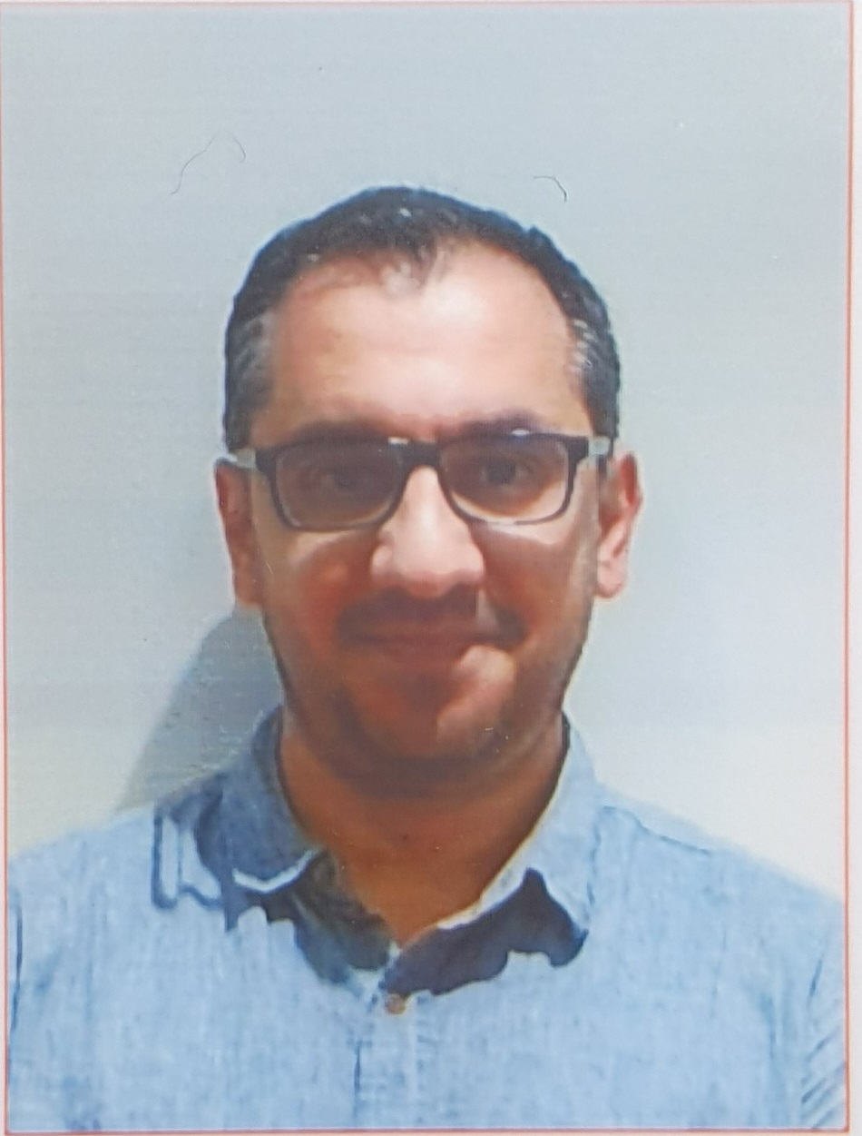
Introduction to Software Engineering (ISE102) Tutorial Week 12

Slide 2
Week 12 Outline
Preparation for Quiz 2 (Python)
Preparation for Quiz 2 (Java)
Showcase Q&A Preparation (for Java & Python Developer Teams)
What You Learned (Selfie & Celebration)
Showcase Presentation Scheduling & Student Communication
Quiz Time (Second Half of the Class)

Slide 3
Preparation for Quiz 2 (Python)
Week 9 – Files, Exceptions & Testing
Q1. What happens when you open a file using open("data.txt", "r") if the file doesn’t exist? A) It creates a new file automatically B) It returns an empty string C) It raises a FileNotFoundError D) It ignores the error and continues
Answer: C Reason: In read mode "r", Python raises a FileNotFoundError if the file doesn’t exist.

Slide 4
Preparation for Quiz 2 (Python)
Q2. What is the purpose of the finally block in Python’s exception handling? A) To handle specific errors B) To execute only if no exception occurs C) To run code that must always execute (like closing files) D) To stop the program
Answer: C Reason: finally runs no matter what, even if an exception or return occurs.

Slide 5
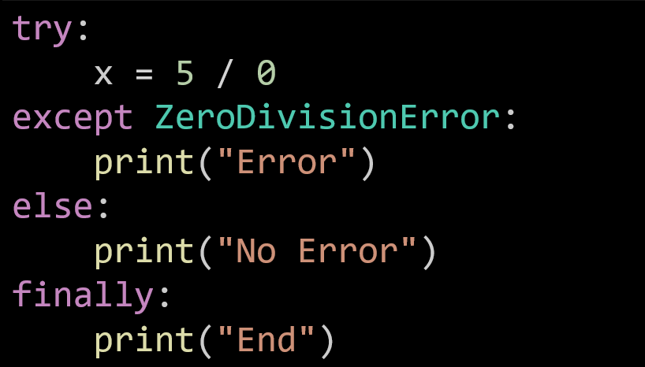
Preparation for Quiz 2 (Python)
Q3. Given the code below, what is printed?
A) Error End B) No Error End C) End Error D) Only End
Answer: A Reason: The ZeroDivisionError runs the except block and then the finally block.

Slide 6
Preparation for Quiz 2 (Python)
Q4. Which statement is correct about Python unit tests using unittest? A) Every test method must start with the word check B) Tests are grouped in classes that inherit unittest.TestCase C) assertEqual() is used only in main() functions D) unittest can test only one function per file
Answer: B Reason: Each test class must inherit from unittest.TestCase to use assert methods.

Slide 7
Preparation for Quiz 2 (Python)
Q5. Which file mode lets you add data without deleting old content? A) "w" B) "a" C) "r" D) "x"
Answer: B Reason: "a" means append mode – it writes at the end without overwriting.

Slide 8
Preparation for Quiz 2 (Python)
Week 10 – Tkinter GUI
Q6. Which Tkinter widget displays non-editable text to the user? A) Entry B) Label C) Button D) Listbox
Answer: B Reason: Label is for showing text, not for user input.

Slide 9
Preparation for Quiz 2 (Python)
Q7. What does the pack() method in Tkinter do? A) Destroys the widget B) Adds the widget to the window using automatic layout C) Creates an event loop D) Changes background color
Answer: B Reason: pack() manages widget placement inside the window automatically.

Slide 10
Preparation for Quiz 2 (Python)
Q8. Which widget is best for selecting multiple items from a list? A) Radiobutton B) Checkbutton C) Listbox with selectmode=MULTIPLE D) Entry
Answer: C Reason: Listbox can allow multi-selection when selectmode is set to MULTIPLE.

Slide 11
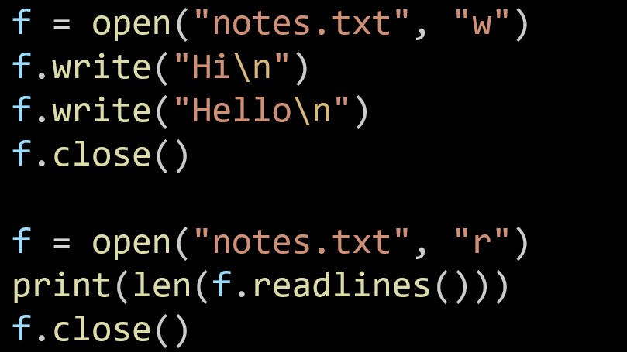
Preparation for Quiz 2 (Python)
Q9. (2 pts) — File Handling What will be printed by this code?
A) 0 B) 1 C) 2 D) 3
Answer: C Reason: Two lines (Hi, Hello) were written; readlines() returns a list with 2 items.

Slide 12
Preparation for Quiz 2 (Python)
Q10. (2 pts) — Tkinter GUI Which Tkinter widget lets a user scroll through a long text area? A) Scrollbar B) Canvas C) Radiobutton D) Listbox
Answer: A Reason: Scrollbar is attached to widgets like Text or Listbox to navigate long content.

Slide 13
Preparation for Quiz 2 (Python)
Q11. (2 pts) — Files What happens if you open a file using open("log.txt", "x") when it already exists? A) It opens the file for writing B) It overwrites the file C) It raises a FileExistsError D) It reads the file content
Answer: C Reason: Mode "x" creates a new file but fails if the file already exists.

Slide 14
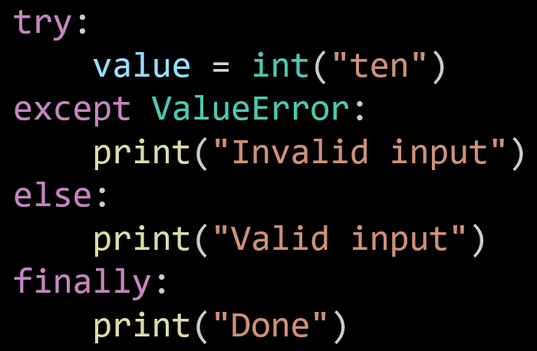
Preparation for Quiz 2 (Python)
Q12. (2 pts) — Exceptions What output will this code produce?
A) Invalid input Done B) Valid input Done C) Done Invalid input D) Only Done
Answer: A Reason: int("ten") raises ValueError; the except and finally blocks execute

Slide 15
Preparation for Quiz 2 (Python)
Q13. (2 pts) — Tkinter Layout Which method arranges widgets by specifying row and column positions? A) place() B) pack() C) grid() D) align()
Answer: C Reason: grid() lets you organize widgets in a table-like layout with row/column indices.

Slide 16
Preparation for Quiz 2 (Python)
Q14. (2 pts) — Tkinter Events When binding a button click using button.bind("<Button-1>", handler), what does handler represent? A) A variable name B) A function that runs when the button is clicked C) The button text D) A widget color
Answer: B Reason: handler is a callback function that executes when the left-mouse button is clicked.

Slide 17
Preparation for Quiz 2 (Java)
Java – New Multiple Choice Questions (Weeks 9 & 11)
Week 9 – Files, Exceptions & Testing
Q1. What happens when you use FileReader("notes.txt") and the file does not exist? A) It creates a new empty file B) It throws FileNotFoundException C) It returns null D) It compiles but shows nothing
Answer: B Reason: Java throws a checked FileNotFoundException when the file is missing.

Slide 18
Preparation for Quiz 2 (Java)
Q2. Which statement is true about try-catch-finally in Java? A) finally executes only if catch runs B) finally never runs if an error occurs C) finally always runs whether exception occurs or not D) finally must come before catch
Answer: C Reason: finally executes after try and/or catch blocks every time.

Slide 19
Preparation for Quiz 2 (Java)
Q3. Which class should you extend to create your own custom exception? A) Exception B) Error C) Throwable D) Runtime
Answer: A Reason: User-defined checked exceptions extend Exception.

Slide 20
Preparation for Quiz 2 (Java)
Q4. What does assertEquals(10, sum(5, 5)) do in JUnit? A) Compares two numbers and fails if they’re different B) Adds 10 and 5 C) Prints the result D) Stops execution of the program
Answer: A Reason: assertEquals verifies that expected and actual values match.

Slide 21
Preparation for Quiz 2 (Java)
Q5. Which stream would you use to write binary data to a file in Java? A) BufferedReader B) DataOutputStream C) PrintWriter D) FileReader
Answer: B Reason: DataOutputStream writes binary (primitives, bytes) to files.

Slide 22
Preparation for Quiz 2 (Java)
Week 11 – JavaFX GUI
Q6. Which layout arranges elements in a grid of rows and columns? A) BorderPane B) HBox C) GridPane D) VBox
Answer: C Reason: GridPane positions nodes by row/column coordinates.

Slide 23
Preparation for Quiz 2 (Java)
Q7. Which JavaFX node hides user input (such as passwords)? A) TextField B) PasswordField C) Label D) TextArea
Answer: B Reason: PasswordField masks input with dots or asterisks.

Slide 24
Preparation for Quiz 2 (Java)
Q8. In an FXML application, what does fx:id do? A) Defines the button label text B) Links a UI component to a controller variable C) Creates a new thread D) Handles the window title
Answer: B Reason: fx:id connects an FXML control to its Java controller field.

Slide 25
Preparation for Quiz 2 (Java)
Q9. Which JavaFX method is used to make a window visible on screen? A) open() B) show() C) display() D) render()
Answer: B Reason: stage.show() renders and displays the window to the user.

Slide 26
Preparation for Quiz 2 (Java)
Q10. What happens if you forget to call Application.launch() in a JavaFX program? A) The UI still opens automatically B) The program compiles but throws an error at runtime C) The window opens without controls D) Nothing – the main method runs normally
Answer: B Reason: Without launch(), the JavaFX runtime is never started, causing a runtime error.

Slide 27
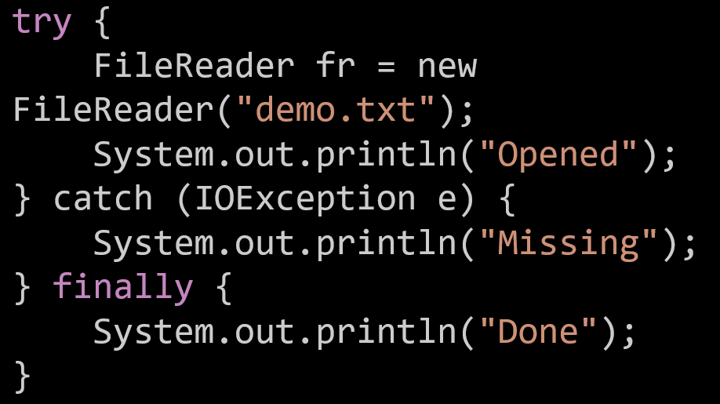
Preparation for Quiz 2 (Java)
Q11. (2 pts) — Exceptions & Files What is printed by this code fragment?
Answer: B Reason: If demo.txt is missing, FileReader throws IOException; the catch runs then finally executes.
A) Opened Done B) Missing Done C) Only Opened D) Only Done

Slide 28
Preparation for Quiz 2 (Java)
Q12. (2 pts) — JavaFX GUI Which JavaFX control allows the user to choose one item from a drop-down list? A) TextField B) ComboBox C) ListView D) CheckBox
Answer: B Reason: ComboBox provides a drop-down for selecting a single option.

Slide 29
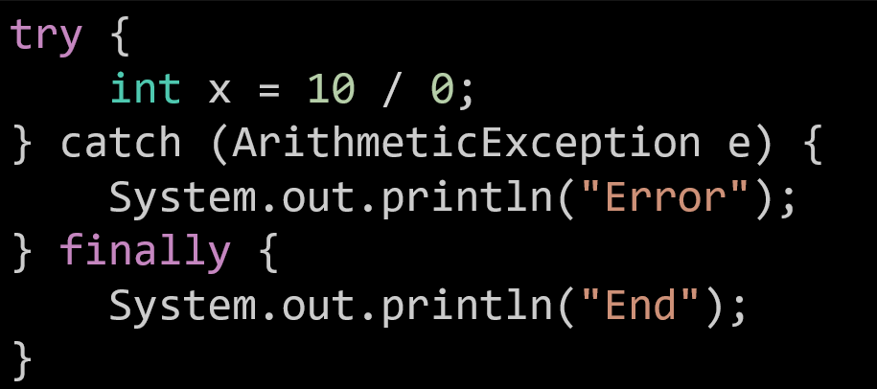
Preparation for Quiz 2 (Java)
Q14. (2 pts) — Exceptions What will this program print?
A) Error End B) End Error C) Only Error D) Only End
Answer: A Reason: Division by zero throws ArithmeticException; the catch and finally blocks both run.

Slide 30
Preparation for Quiz 2 (Java)
Q15. (2 pts) — JavaFX Controls Which JavaFX control allows a user to select multiple items at once? A) ComboBox B) ListView with SelectionMode.MULTIPLE C) RadioButton D) TextArea
Answer: B Reason: ListView can enable multi-selection through its selection model settings.

Slide 31
Preparation for Quiz 2 (Java)
Q16. (2 pts) — JavaFX Lifecycle Which JavaFX method is called automatically after launch() to set up the UI? A) main() B) init() C) start(Stage primaryStage) D) render()
Answer: C Reason: start() is the entry point where you build the stage and scene after the JavaFX runtime starts.

Slide 32
Showcase Q&A Preparation (for Java & Python Developer Teams)
As you prepare for your Showcase presentation (Part 3), please review this Sample Question List. These are the kinds of questions I may ask about your design, logic, testing, and teamwork. You don’t need to memorise answers — just be ready to explain your own code and what you learned.

Slide 33
Showcase Q&A Preparation (for Java & Python Developer Teams)
By now, each group should demonstrate:
Technical fluency: Writing functional, modular code in Java or Python.
Data handling: Reading/writing to local files (students.data), serialization, and validation.
Design understanding: Applying Model–View–Controller (MVC) logic, separating UI logic from backend data handling.

Slide 34
Showcase Q&A Preparation (for Java & Python Developer Teams)
Regex validation: Implementing correct email and password rules.
Error handling: Managing edge cases (duplicate student, invalid input, subject limit, etc.).
Testing & debugging: Matching outputs to given sample I/O.
Collaboration: Integrating each member’s work into one consistent system.

Slide 35
Showcase Q&A Preparation (for Java & Python Developer Teams)
Concept & Design (5 examples)
How does your implementation follow the MVC structure?
What data structures did you use to store subjects and students, and why?
Explain how your program handles persistence — what happens when the system restarts?
How did you ensure the system remains scalable if more features were added?
Describe one key difference between your CLI and GUI implementation.

Slide 36
Showcase Q&A Preparation (for Java & Python Developer Teams)
Coding & Logic (Java / Python variants)
How did you validate emails and passwords using regex?
What method generates unique IDs for students and subjects?
Can you explain how marks and grades are calculated?
How does your code prevent enrolment beyond four subjects?
If the students.data file doesn’t exist, what happens?

Slide 37
Showcase Q&A Preparation (for Java & Python Developer Teams)
(Optional follow-ups for each language)
Java: How did you use FileOutputStream, ObjectOutputStream, or Collections?
Python: How did you use pickle / json, and how did you handle exceptions with try–except?

Slide 38
Showcase Q&A Preparation (for Java & Python Developer Teams)
Error Handling & Testing
What exceptions or input errors did you anticipate and handle?
How did you test your system to confirm all menus and file operations worked?
What happens if an admin removes a student currently enrolled in subjects?
How did you verify data integrity after write/read operations?

Slide 39
Showcase Q&A Preparation (for Java & Python Developer Teams)
GUI (for teams who attempted it)
How does your GUI interact with the backend data file?
How do you manage window transitions (Login → Enrolment → Subject list)?
Which GUI framework did you use (Tkinter / JavaFX), and why?
How did you handle empty input or invalid login attempts in the GUI?

Slide 40
Showcase Q&A Preparation (for Java & Python Developer Teams)
Reflection & Teamwork
What was your biggest coding or integration challenge, and how did you solve it?
How did your group divide and merge tasks effectively?
What new skills or tools did you learn through this project?
If you could redesign one feature, what would it be and why?
How does this project prepare you for real software development roles?

Slide 41
What You Learned (Selfie & Celebration)
What an incredible journey!
Over the past few weeks, our students transformed an idea into a fully functional Student Management System — designing, coding, debugging, and showcasing their work with pride! They mastered #Java and #Python, explored #ObjectOrientedDesign, built #GUI apps with JavaFX and Tkinter, and learned the true value of #Collaboration and #Agile teamwork.

Slide 42
What You Learned (Selfie & Celebration)
Congratulations to all future developers — you’ve turned ideas into real software! Take a selfie-celebration and share your success with pride!
#FundamentalSoftwareDevelopment #Java #Python #UML #Innovation #TeamWork #LearningByDoing #SoftwareEngineering #StudentSuccess #UTS #FutureDevelopers #CodingCommunity

Slide 43
Showcase Presentation Scheduling & Student Communication
Hi Farshid,
I hope you’re doing well.
I’m writing to confirm the schedule for our Assessment 1 – Part 3 showcase presentation for Group- 3. Our group would like to request that our Assessment 1 – Part 3 showcase presentation be scheduled during Week 13 of our usual class hours. Please let us know if this can be accommodated for updating the registration sheet accordingly.
Kind Regards,

Slide 44
Showcase Presentation Scheduling & Student Communication
Dear Student,
Thank you for your message and for confirming your group’s preference. That works perfectly — since Week 13 begins on 3rd November, we can schedule your showcase during our regular class time.
Please ensure your group is ready to present the working application and that each member explains their own contribution as outlined in the presentation guidelines. I look forward to seeing your project in action!
Kind regards, Dr. Farshid Keivanian

Slide 45
Showcase Presentation Scheduling & Student Communication
Dear Farshid,
Thanks for your response. As you have mentioned that you will be available from the 27 October – 2 November. Our request is that we would like to give the presentation on the 2nd of November as we would like to complete and review our application . We will not be able to present it on the 28th as we have other assignments due while this was scheduled for 7th November according to canvas.
To summarise we would like to present you our assignment on the 2nd of November with the guidelines mentioned in the previous mail . If you’re not available as it is a Sunday, we would request to give it as per the dates in canvas i.e. on the 7th of November. Please feel free to let us know your availability accordingly.

Slide 46
Showcase Presentation Scheduling & Student Communication
Dear ….,
Thank you for your message and for confirming your group’s preference. I completely understand your situation and appreciate your proactive communication.
Presenting on Sunday, 2nd November is perfectly fine — I’ll schedule your group for that date during the same 5:15 PM – 7:15 PM online window via Microsoft Teams. A meeting link will be shared closer to the time/date along with your final presentation slot.

Slide 47
Showcase Presentation Scheduling & Student Communication
If any unforeseen issue arises with that timing, we can revisit your request for Week 13 starting 3rd Nov (as per regular class) as a backup option.
Please continue refining your project and ensure that each member prepares to present their individual contribution clearly during the session. I look forward to seeing your showcase!
Kind regards,
Dr. Farshid Keivanian

Slide 48
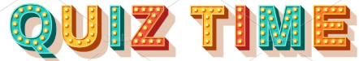
Quiz Time (Second Half of the Class)
Tuesday, Oct 21 and Friday, Oct 24: Password will be announced during the class
The quiz will open during the second half of each class.
You’ll need a password to start — it will be shared live during class.
Please do not share the password outside the session.
Ensure your internet connection is stable before starting.

Slide 49

Happy Learning and Bright Futures Ahead! Dr. Farshid Keivanian Stay Connected: linkedin.com/in/farshid-keivanian github.com/FarshidKeivanian
Education is the most powerful weapon you can use to change the world. — Nelson Mandela

